Slide 1
SDC – sustainable Development Commission
26th – 28th October, Stockholm contribution to the Round Table
Company Name: Västtrafik
My Name: Sara Gärtner
To return by mail until October 20th to heipp.gunnar@swm.de

Slide 2

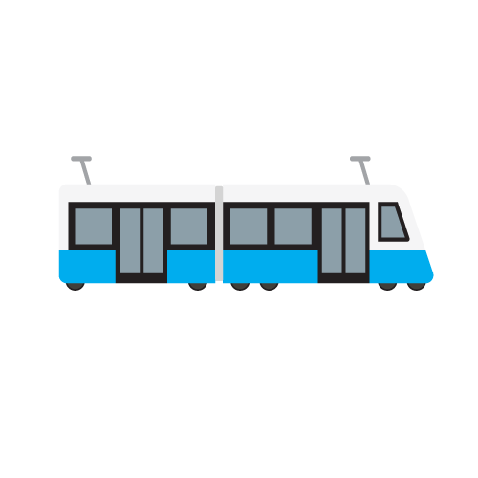


My company’s current state of Sustainable Procurement
Environmental demands CO2 reduction.
Renewable fuels with high CO2 reduction.
Demands on emissions of NO2, particle matters, noise level, and demands on an active work with environmental issues ISO 14000.
Try to start to include social demands in procurement together with the Swedish branch. Risk assessment has been done with procurement concerning vehicles and traffic service. We will develop contracting demands based on the outcomes of the risk assessment, work continues.

Slide 3

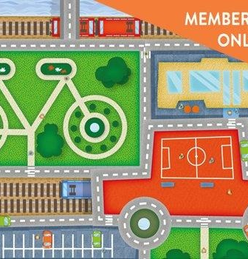
My company’s Current activities Around Health + Public Transport
Västtrafik is working with Combined mobility and is now procuring a technical platform to be able to combine public transport with other sustainable modes and services, such as bicycle rent, goods delivery and car-sharing
Combined mobility for sustainable modes

Slide 4






My company’s activities to promote the role of public transport for a sustainable city
Developed and endorsed a definition of Sustainable development for Västtrafik, including environmental, social, (society and staff) and economic dimensions.
All units will revise how they can contribute to the definition and add activities and outputs to be able to reach the goals in the definition.
For example: Our Infrastructure department is developing a manual for the buildings/terminals and the maintenance.

Slide 5
SDC – sustainable Development Commission
26th – 28th October, Stockholm contribution to the Round TaBLE
ESG Matters Limited
Dr Glenn Frommer

Slide 6
ESG Matters’ activities to promote the role of public transport for a sustainable city
13th UIC International Conference on Railway Sustainability
330 Participants representing 25 countries, hosted by OBB
Focused on delivering SDGs
    Ensuring integrated policy
    Rail and Sustainble Development in Europe
    Railways delvering SDGs
    Railways and Livable Citied (GF)
    Sustainable Energy
A

Slide 7
ESG Matters’ activities to promote the role of public transport for a sustainable city
Workshops
  Carbon footprinting in railways
  Digital communication and energy efficiency in railways
  Railway noise in the common noise assessment methodology
  Sustainable procurement
  Sustainable tourism (GF)
  Emissions and air quality
  Energy efficiency project: potential improvements
  GRI G4 Reporting – challenge sof rthe rail sector (GF)
  Recyclability of rolling stock
  Weather resilience and climate change adaptation
  Biodiversity preventing decline
  Door to door business solutions
  Environmental management for maintenance acitivties
  Sustainable and smart stations and infrastructure

Slide 8
ESG Matters’ activities to promote the role of public transport for a sustainable city
GRI G4 Workshops
  GRI and P&L Accounting
  The ‘Perfect Storm‘ for railway investment
    Negative interest worldwide
    Railways decarbonize portfolios
    Railways have steady cash flow – can repay loans
    Opportunity for Pension Funds and other investors

Slide 9

ESG Matters’ activities to promote the role of public transport for a sustainable city

Slide 10
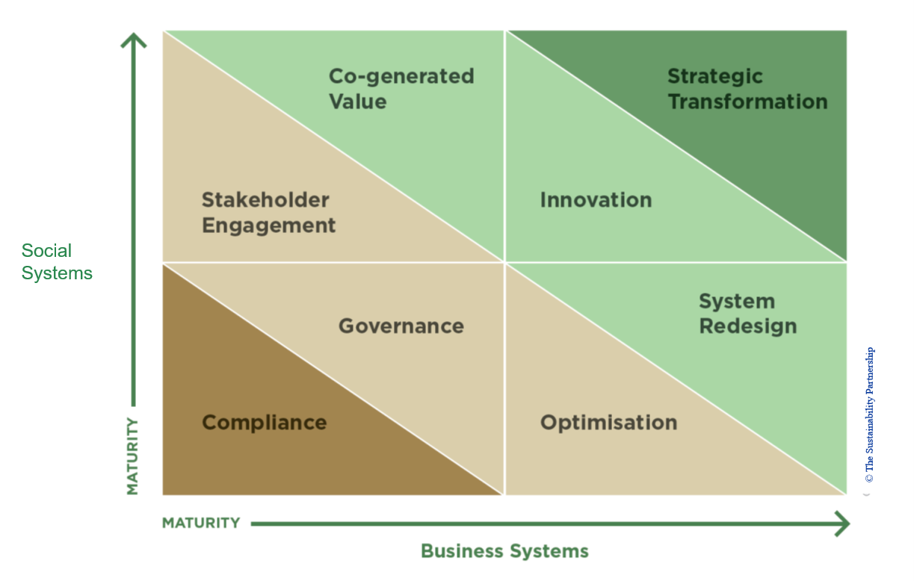
ESG Matters’ activities to promote sustainability - GPS 2.0

Slide 11
SDC – sustainable Development Commission
26th – 28th October, Stockholm contribution to the Round Table
Société de transport de Montréal
André Porlier
To return by mail until October 20th to heipp.gunnar@swm.de

Slide 12
Integration of sustainable development criteria into decision-making processes
1. Project prioritization : Project portfolio management
2. Project development : Design standards and criteria
3. Selection of products and suppliers: Sustainable procurement
4. Recommendations submitted to the Board of Directors: Review of compliance with the sustainable development policy
Notes:
4 others elements are more technical:

Slide 13
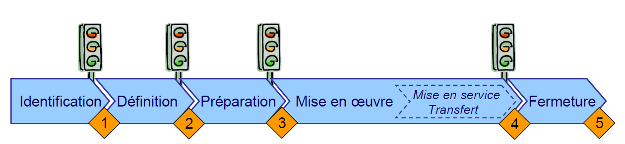
Project portfolio management
Rigorous process to prioritize investment projects - Five stages reflect the life cycle of a project
Since 2011, each project description must highlight its contribution to sustainable development
Role of sustainable development team:
  Support project managers in identifying project’s contribution to sustainable development
  Develop tools and guides to help identify upstream options to maximize environmental, social and economic benefits
  Establish guidelines to factor in sustainability contribution in project prioritization
Notes:
STM implemented a rigorous process to prioritize its investment projects. Only those who meet the criteria established by the project portfolio management (GPP) committee are prioritized. As early as in 2011, a sustainability component was included into the GPP process to obtain a maximum of economic, social and environmental benefits. In 2014, STM will add to this process by drawing up a checklist of concerns with regards to its 2020 Sustainable Development Plan.
The STM's project portfolio management process (an evaluation grid for major projects) integrates sustainability criteria. Such a process helps project managers take into consideration any and all sustainability issues from the very start.
The STM's project portfolio management includes criteria for sustainability. Moreover, with LEED certification for new buildings, the STM can include cost savings targets from sustainable choices.

Slide 14
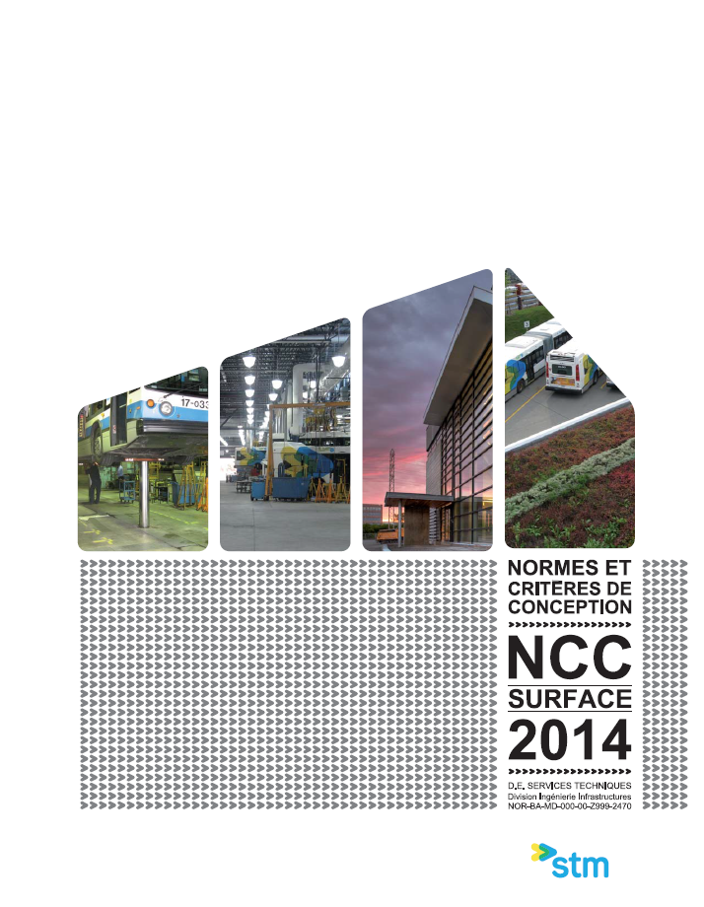

Design standards and criteria
Provide the terms of reference for all STM engineering projects
Revision every two years: sustainability criteria are gradually added to the document
  green spaces, energy-efficient equipment, eco-friendly management of residual waste, etc.
Role of sustainable development and environment teams
  gradual upgrade of sustainability criteria based on available technologies and corporate priorities and commitments (e.g. SD Plan 2020 aims for LEED certification of all new construction projects)
Notes:
Sustainability criteria integrated into STM’s design standards and criteria (NCC): These provide the terms of reference for all STM engineering projects. Sustainability criteria were gradually added to the document. Thus, sustainable development concerns are taken into account early in the planning stage (inclusion of green spaces, priority to the most energy-efficient equipment, eco-friendly management of residual waste, etc.)
Also, the department for the Environment incorporates environmental criteria in the Standards and Design Criteria for new projects.

Slide 15
Corporate guidelines on sustainable procurement
Scope: All STM contractual agreements (acquisition and disposal of goods and services)
5 Principles: promote as much as possible …
  Impact reduction through the life cycle of all goods
  Local and regional purchasing
  Principles established by ILO, the International Labour Organization, and proclaimed in the Universal Declaration of Human Rights
  Commitment of suppliers to sustainability
  Ecodesign and innovation of suppliers
Tools:
  Handbook for application of guidelines
  Guide on certifications
  Awarness and training program
  Coaching by a member of sustainable development team

Slide 16
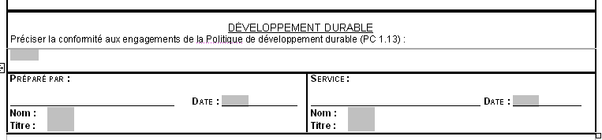
Recommendations submitted to the Board of Directors
Since 2012, all recommendations submitted to the Board of Directors must contain details demonstrating that they comply with the commitments outlined in the sustainable development policy
Role of sustainable development team:
  Review all recommendations to maximize their environmental, social and economic benefits
  Challenge recommendations when appropriate
  Help highlight each recommendation’s contribution to sustainability
Notes:
Recommendations submitted to the Board of Directors: Since 2011, all recommendations presented to STM’s governing board include a section pertaining to sustainable development concerns.
Board of Directors’ committee for sustainable development: In January 2014, STM established a new board committee responsible for validating the direction taken by STM in terms of sustainability.

Slide 17

Our results
SDP 2020 Targets
2015 2012 2013 Goal 2020
Percentage of the value of contracts in progress during the year that include sustainable development criteria Percentage of contracts in progress during the year that include sustainable development criteria
74% 33% 54% 90%
27% 17% 19% 90%

Slide 18
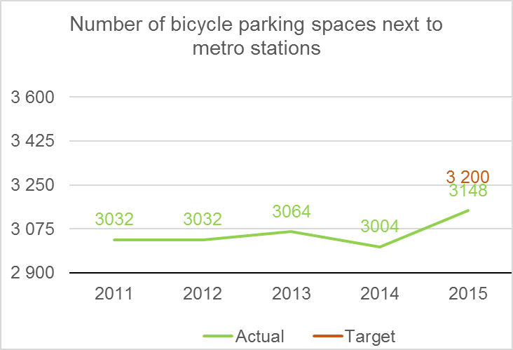
STM Current activities Around Health + Public Transport
Bikesharing (BIXI):
A joint BIXI-STM working committee was set up in 2015.
This led to better locating of BIXI docking stations
During the 2015 BIXI season, 100% of metro stations in the BIXI territory had a docking station within a walking distance of 400 m or less, and 89%, within 200 m or less.
Biking:
The number of bicycle parking spaces totalled 3,148, or nearly 5% more than the previous year, and 1.7% short of the 2015 target of 3,200 spaces.
The bicycle stand usage rate for the network as a whole increased from 41% in 2014 to 45% in 2015.

Slide 19
STM Current activities Around Health + Public Transport
In 2015, we launched the “100% more active” campaign encouraging customers to increase their daily exercise when taking public transit⎯for example, by walking up the stairs.

Slide 20
STM activities to promote the role of public transport for a sustainable city
Economic contributions:
STM reports on Investments in public transit that help generate wealth, create jobs and stimulate Québec’s economy. In 2015, acquisitions of goods and services amounted to $643 million, up from $586 million in 2014, for a 10% increase.
To measure its contribution to the Québec economy, the STM uses the input/output model of the Québec government’s Institut de la statistique.
According to this model, 48% of goods and services acquired in 2015 were produced in Québec.
Our procurement expenditure helped sustain 3,555 jobs in addition to those of the STM’s 9,506 permanent and temporary employees.

Slide 21
STM activities to promote the role of public transport for a sustainable city
GHG Reductions:
STM reports on its contributions to GHG reduction objectives of the city of Montréal and the province of Québec.

Slide 22
SDC – sustainable Development Commission
26th – 28th October, Stockholm contribution to the Round Table
Company Name: Verkehrsbetriebe Karlsruhe
My Name: Markus Klehr
To return by mail until October 20th to heipp.gunnar@swm.de

Slide 23
My company’s current state of Sustainable Procurement
Actual projects concerning state of the tracks:
Advices for improvement
Project: Examination of the special wear behaviour of wheel-to-rail due to the conditions of (Karlsruhe-)tram-train system
Procurement of vehicles that adhere to the strictest emission standards.
Order of energy recuperation modules (to store braking energy) for the busses. In combination with special doors we hope to save fuel by 2-4%.

Slide 24
My company’s Current activities Around Health + Public Transport
Participation in nationwide project:
Measures for a sustainable company mobility management, e.g. improvement of occuptional health through increase use of bikes
Information events about health / movement and healthy eating
„Healthy Day“
Cooperation with fitness center
„Health-Licence“

Slide 25
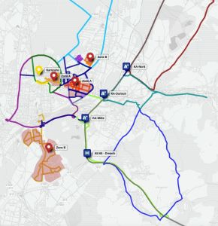
My company’s activities to promote the role of public transport for a sustainable city
Strategy for development of „Karlsruher-Modell“ after 2022
Project-Lead test-field autonomous driving:
  companies and research institutes could test autonomous driving in everyday road traffic
  Integration of public transport and not
  only motorised individual transport

Slide 26
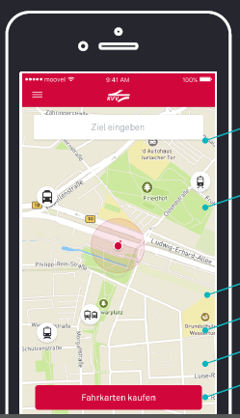
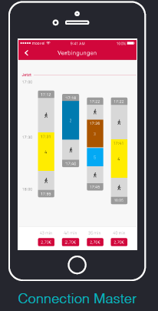
My company’s activities to promote the role of public transport for a sustainable city
Moovel: Puplic transport App for information and buying
Search functions
Interactive maps
Sales User Payment
Integration of Car Sharing,
Bike Sharing

Slide 27
My company’s activities to promote the role of public transport for a sustainable city
Project RegioMOVE funded project by 4,9 Mio of the federal state of Baden-Wuerttemberg:
Development of transport association KVV to a mobility network.
Further line-up of mobility offers in particular: integration of
Carsharing- and Bikesharing provider in existing KVV-System
Contruction of mobility stations at central points in the city and region. There it will be possible to change e.g. from tram-train ro rental bike, carsharing or bus. RegioMOVE creats all organizational, infrastructural and technical basics for such a mobility network at Karlsruhe.
The project RegioMOVE was award-winning as one of 21 lighthouse projects by a competition for innovation and sustainability.

Slide 28
SDC – sustainable Development Commission
26th – 28th October, Stockholm contribution to the Round Table
WIENER LINIEN GmbH & Co KG
To return by mail until October 20th to heipp.gunnar@swm.de

Slide 29
My company’s current state of Sustainable Procurement
Austrian federal Law is very restrictive -> principles of law head towards sustainibility
Execution on operational level is not always easy (Bestbieterprinzip)
Ecological Footprint as Filter where to look for further improvement
Workshops, fuels, …

Slide 30
My company’s Current activities Around Health + Public Transport
WL make a lot of efford towards full electrification -> zero emissions (local and procurement of renewables)
Austrian federal law for employees give an already tight frame, marginal costs are very high.
Steady monitoring of health status of employees (Gesundheitstage), regular checks, special management scheme for Gesundheitsmanagement and Krankenstandsrückkehrgespräch ;-)
Evaluation of Hazards and Dangers

Slide 31
My company’s activities to promote the role of public transport for a sustainable city
Space Efficiency (Research Programm) see next slide
Ecological Footprint
Energy Efficiency (federal law level, special leaflet for Public Transport and shifted energy from MIT)
TOD with new and enlarged workshop KAGRAN see next next slide.

Slide 32
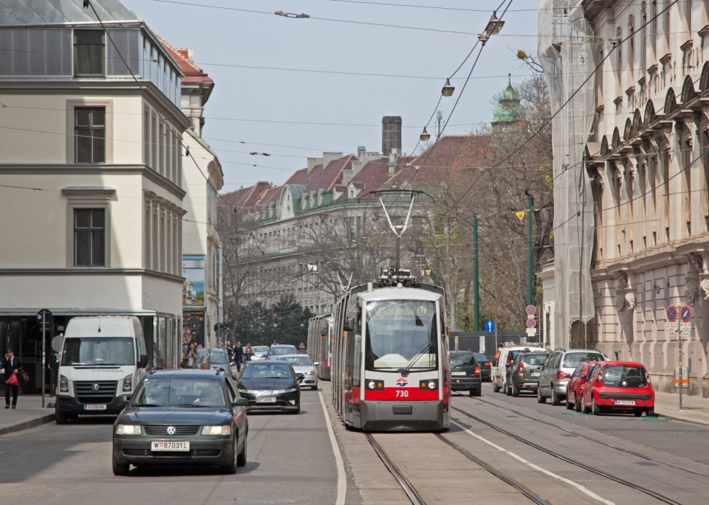
Capacity Comparison
© 2015 Bildstrecke.at

Slide 33
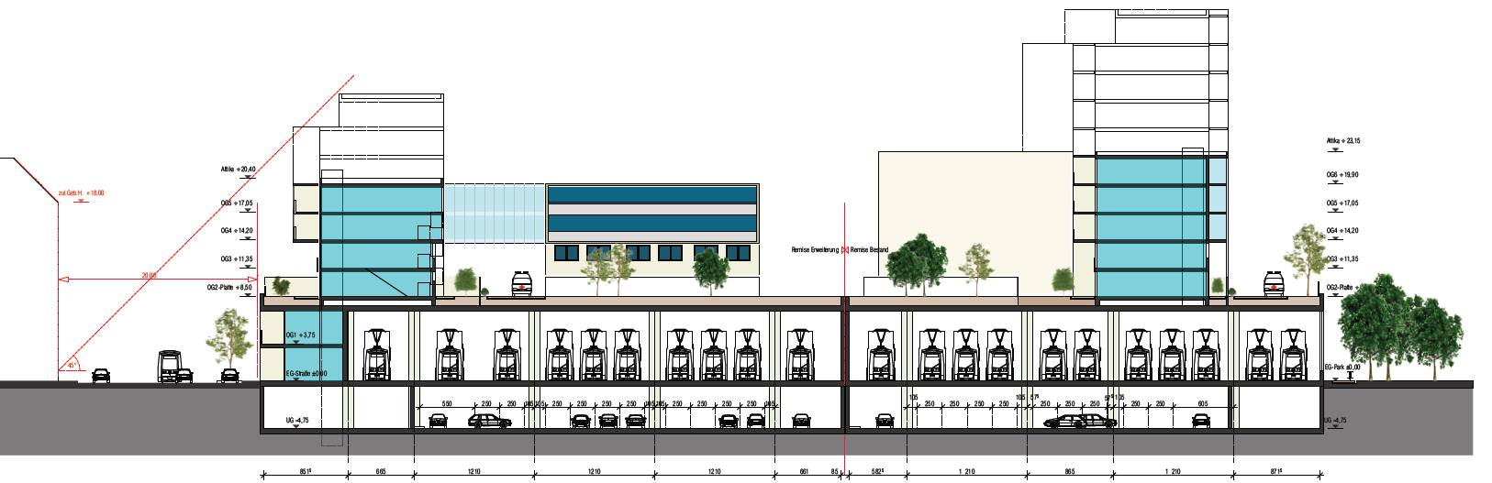
Development Depot Kagran
© 2016 Wiener Linien

